Slide 1
Time series workshop

Slide 2
Contents
Introduction
Matrix Profile
Distances
Clustering
Classic clustering methods
Clustering Based on Shape
Clustering based on features.

Slide 3
Introduction

Slide 4
Who we are?
Zach Zimmerman
Shapelets team
Antonio Vilches
Oscar Torreño
David Cuesta (omnipresent)

Slide 5
This workshop …
What is the aim of the workshop?
Show you new ways to extract information from time-series.
Finding patterns, motifs, discords, ...
What will not be covered
Classic methods.

Slide 6
Disclaimer
All algorithms explained here are published or created by other people, all respect to them.
Matrix Profile and its derivates
Research team of Professor Eamonn Keogh at UC Riverside.
https://www.cs.ucr.edu/~eamonn/MatrixProfile.html
K-Shape
John Paparrizos and Luis Gravano, k-Shape: Efficient and Accurate Clustering of Time Series.

Slide 7
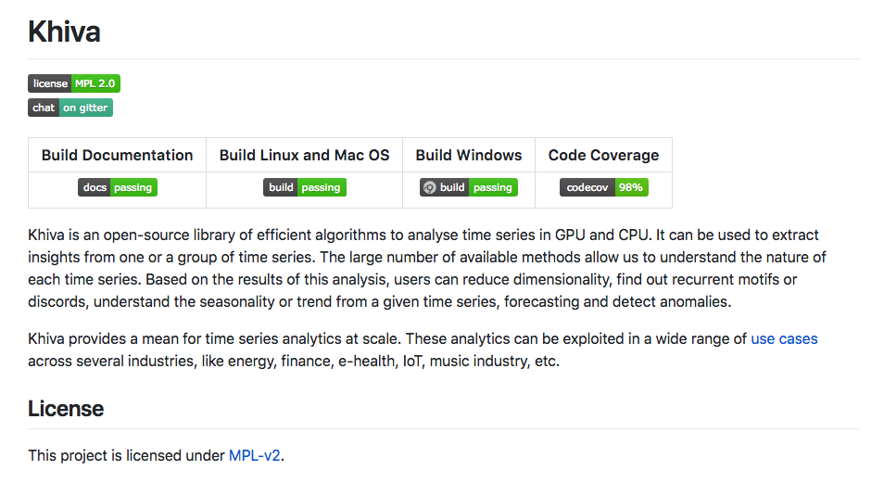
Khiva
Open-Source
Multi-Platform
Binding for Python and others
Acceleration on GPU
https://github.com/shapelets/khiva

Slide 8
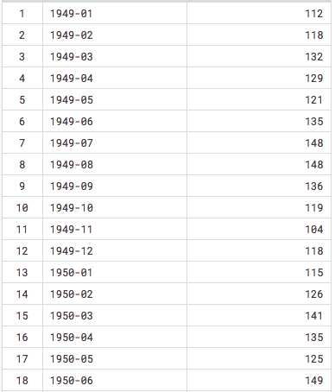
What is a time series?
https://www.kaggle.com/rakannimer/air-passengers

Slide 9
Time series analysis …
TSPreprocess
Traces
SciPY
…
Filtering and conversion
SciPy
NumPy
Statsmodel
…
Statistics
TSfresh
Cesium
…
Feature Extraction
TSlearn
Tensorflow
Caffe
…
Machine Learning
?
…
Pattern Recognition
Prophet
PyFlux
Statsmodel
…
Forecasting

Slide 10
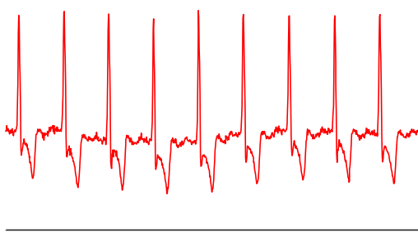
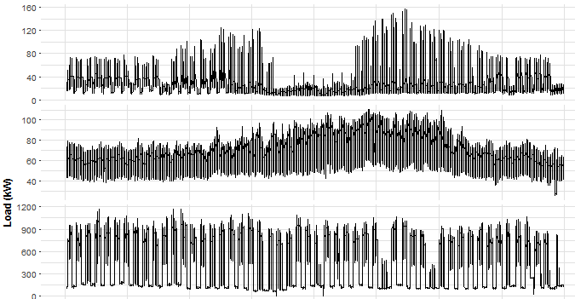
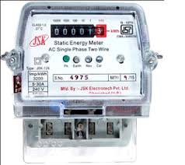
What can I represent with a time-series?
https://www.physionet.org/physiobank/database/ltdb/
https://petolau.github.io/

Slide 11
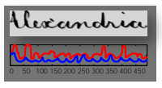
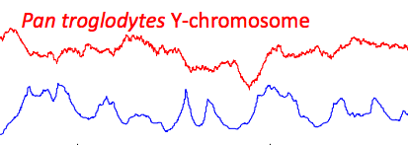
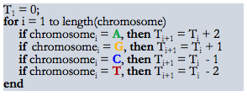
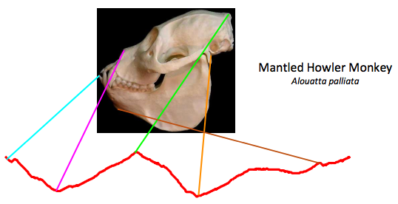
Extending the concept of time series
Use cases:
http://www.cs.ucr.edu/~eamonn/tutorials.html
Notes:
Aquí os traigo algunos ejemplos de como podemos transformar datos para poder tratarlos como time series.

Slide 12

Can you do it? With your algorithms?
Find a pattern in a TS:
200 points
In a TS of 100K points
Real Time?

